Slide 1


CITY ENGINEERING COLLEGE
DEPARTMENT OF COMPUTER SCIENCE AND ENGINEERING
INTERNSHIP PRESENTATION
ON
RED WINE QUALITY ANALYSIS
Under the guidance of:
Mrs. AMBIKA P R
By:
MEGHANA G
1CE17CS059

Slide 2
abstract
Nowadays people try to lead a luxurious life. They tend to use the things either for show off or for their daily basis. These days the consumption of red wine is very common to all. So it has become important to analyze the quality of red wine before its consumption to preserve human health. Hence this research is a step towards the quality prediction of red wine using its attributes. Red wine quality is highly influenced by the qualitative and quantitative composition of aromatic compounds having various chemical structures.

Slide 3
introduction
Machine Learning is a subfield of artificial intelligence(AI). The goal of machine learning is to understand the structure of data and fit that data into models that can be understood and utilized by people.
This project RED WINE QUALITY ANALYSIS is based on the dataset which contains the attributes such as fixed acidity, citric acid, residual sugar, chlorides, free sulphuric acid, total sulphuric acid, density, pH, sulphurs, alcohol, quantity. The prediction is done through various algorithms like Logistic Regression, Support Vector Machine, Decission Tree Classifier, Random Forest Classifier.

Slide 4
Company Profile
The Tech Fortune group was originally incepted in 2013 to focus on EPC assignment of Infra and Real Estate projects. Later the company shifted its focus towards software development. A Software development Firm head quartered in Vijapur and operating for 5 years in with 3 offices across Karnataka.
Tech Fortune Technologies, is an emerging technology organization in the fields of business process outsourcing, software development, end-to-end ERP solutions, Artificial Intelligence, Blockchain technology with a focus on providing customized solutions to the various business needs of a diverse global clientele.

Slide 5
Mission:
Being slow and steady, our mission is to gain the confidence of ou clients and by dint of our integrity, innovation and dynamism, deliver their requirements on time with full quality thus bridging the gap between
demand and delivery.
Vission:
With an unyielding focus on integrity and backed by strong founders and management team , Sourcing wants to make a mark in the field of IT services by applying innovation to simplify complex business processes and add value to clients’ business.

Slide 6
Training content
The Internship was successfully completed from the Tech Fortunes Technologies in the month of September. My guide for the internship training was Chetan Deepl who was a well versed teacher in the field of machine learning. The training took place in online mode and was carried out every day for 2 hours.
They firstly gave a brief introduction to the Python language as it was used for coding in machine learning. There were assignments given on the basics of python programs. Later they explained the Anaconda Jupyter Notebook, how it works, and its uses. There were many small projects that were taught like movie recommendation system, Iris flower Classification and many more. They taught us the Spider application in which we performed conversion of a image to white and black format, a live video in which we can change the colour of a persons clothes, while capturing a picture focusing on the face of the person, and so on.It is easy to debug the errors in Spyder applications as it identifies errors in each line. The different algorithms which we use for getting best accuracies like Linear Regression, K Means, Random Forest, SVM and many more were taught.
Overall it was a useful and a worthful internship program which provided me a lot of knowledge on Machine Learning its algorithms and how we have to estimate the training examples accuracy.

Slide 7
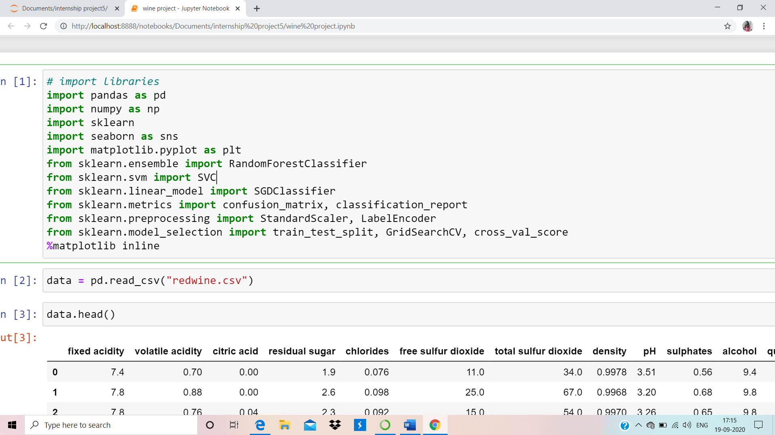
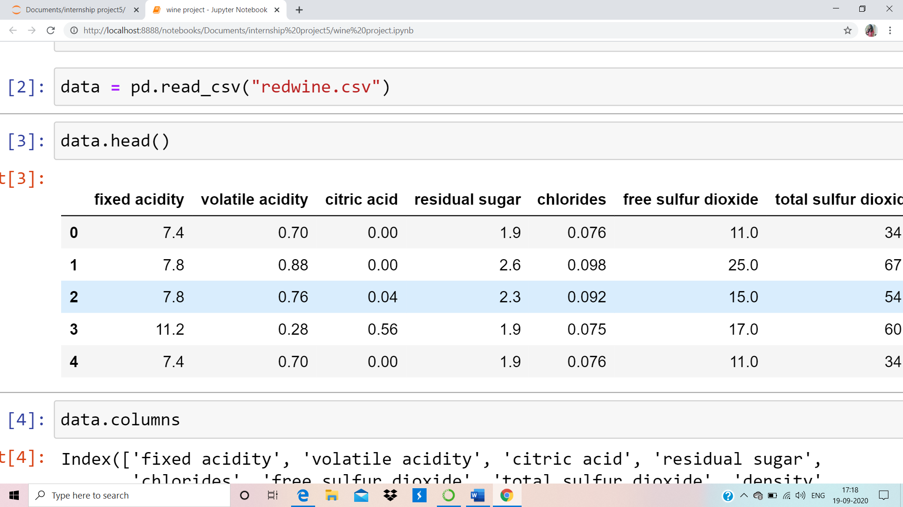
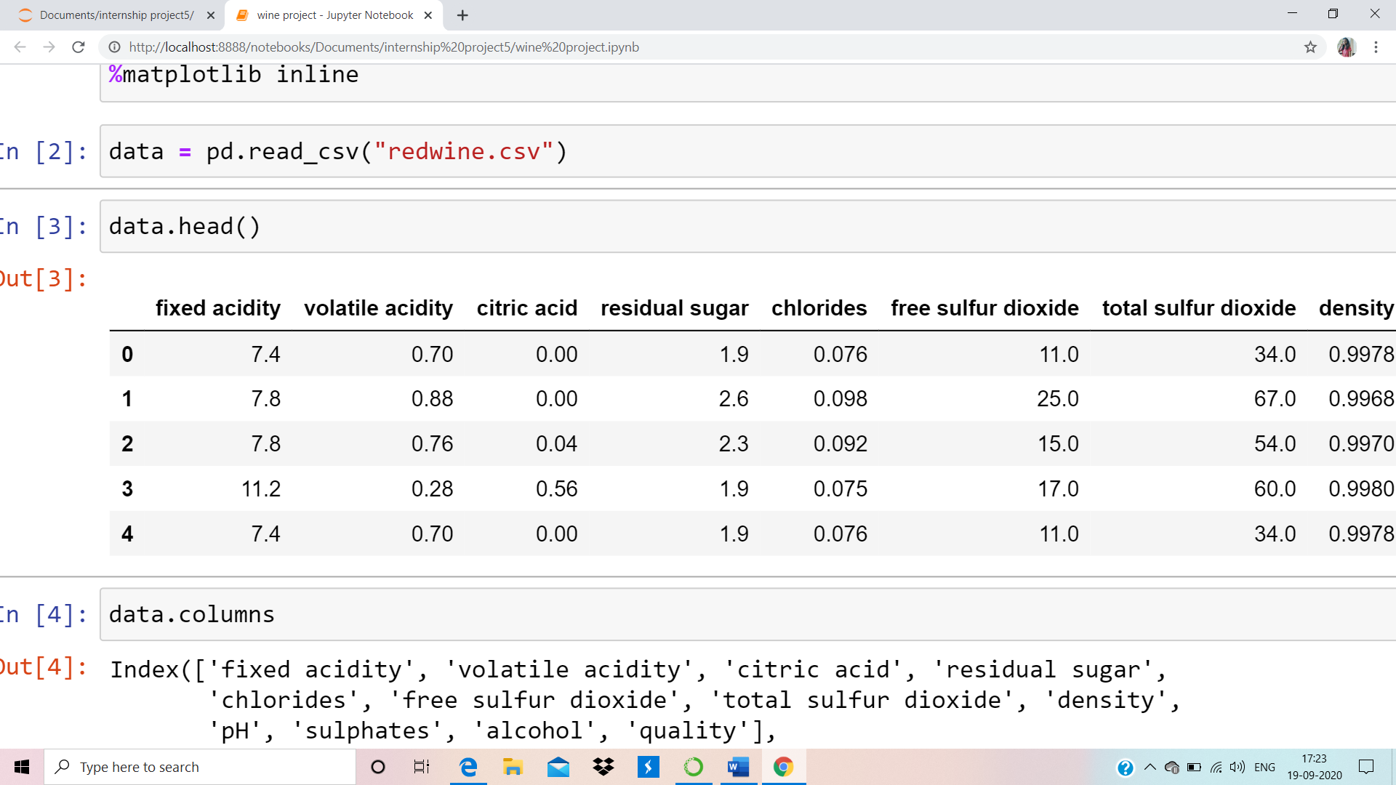
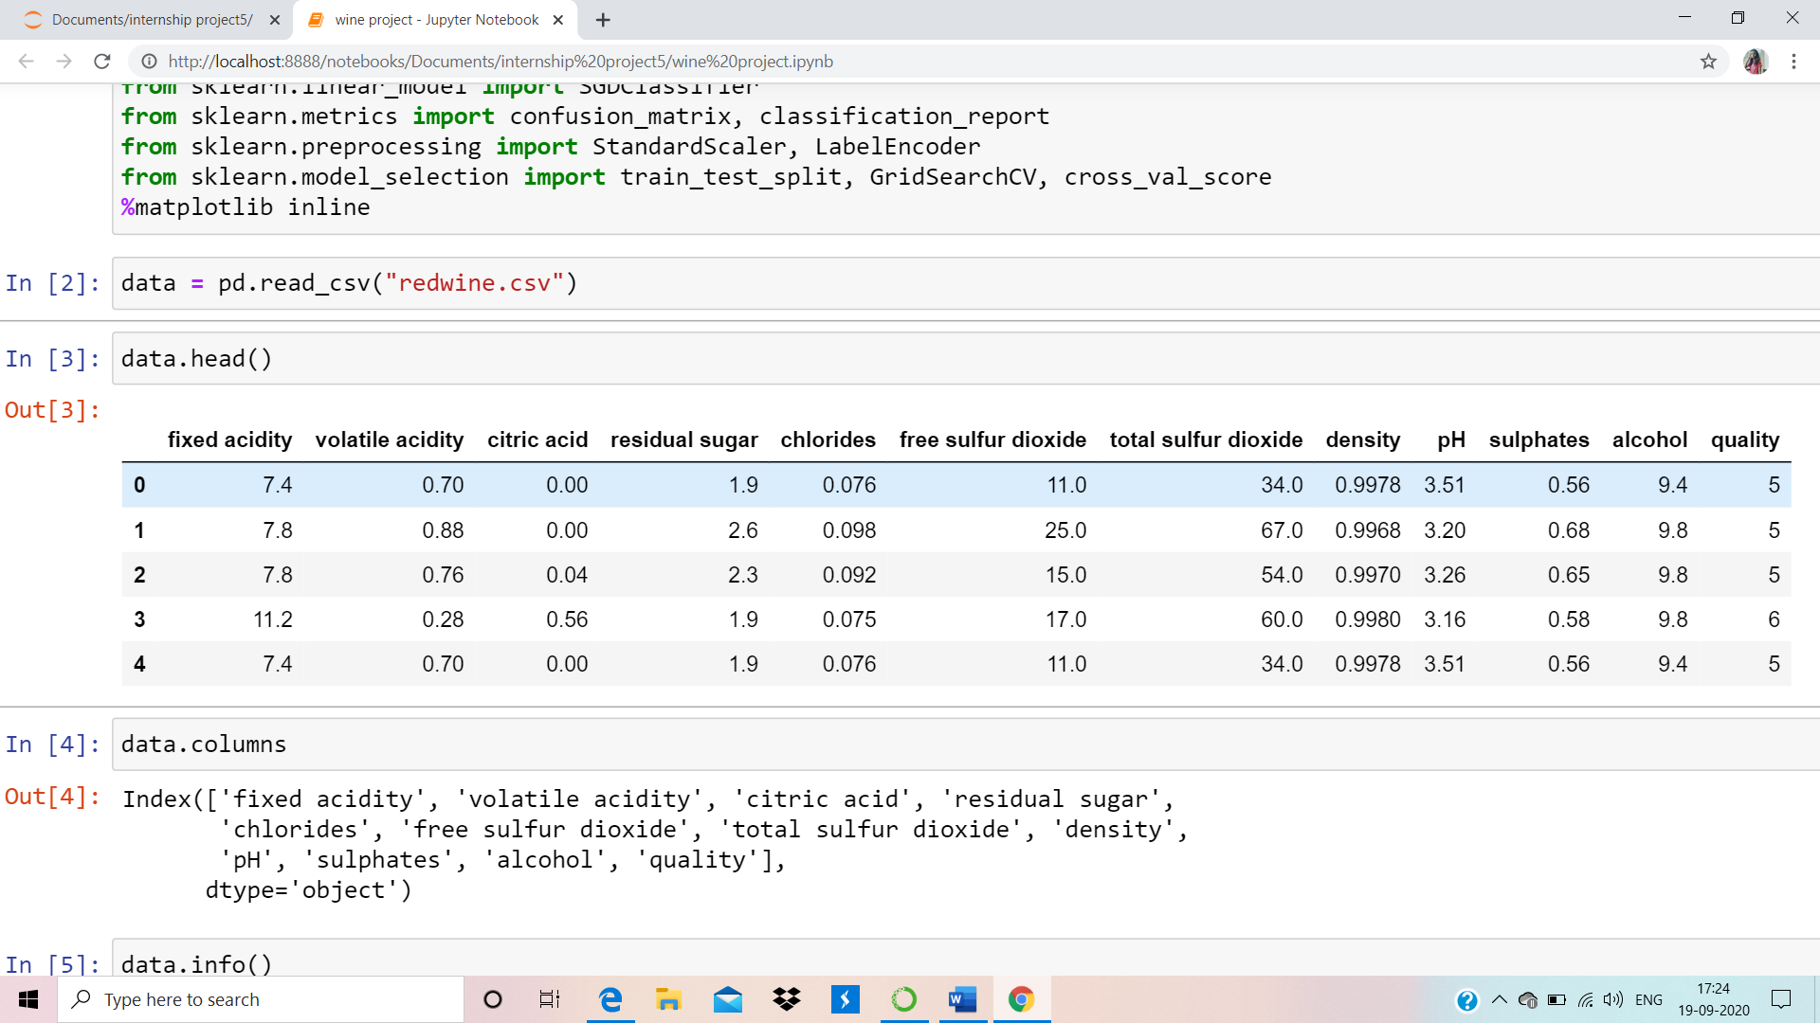

Implementation

Slide 8
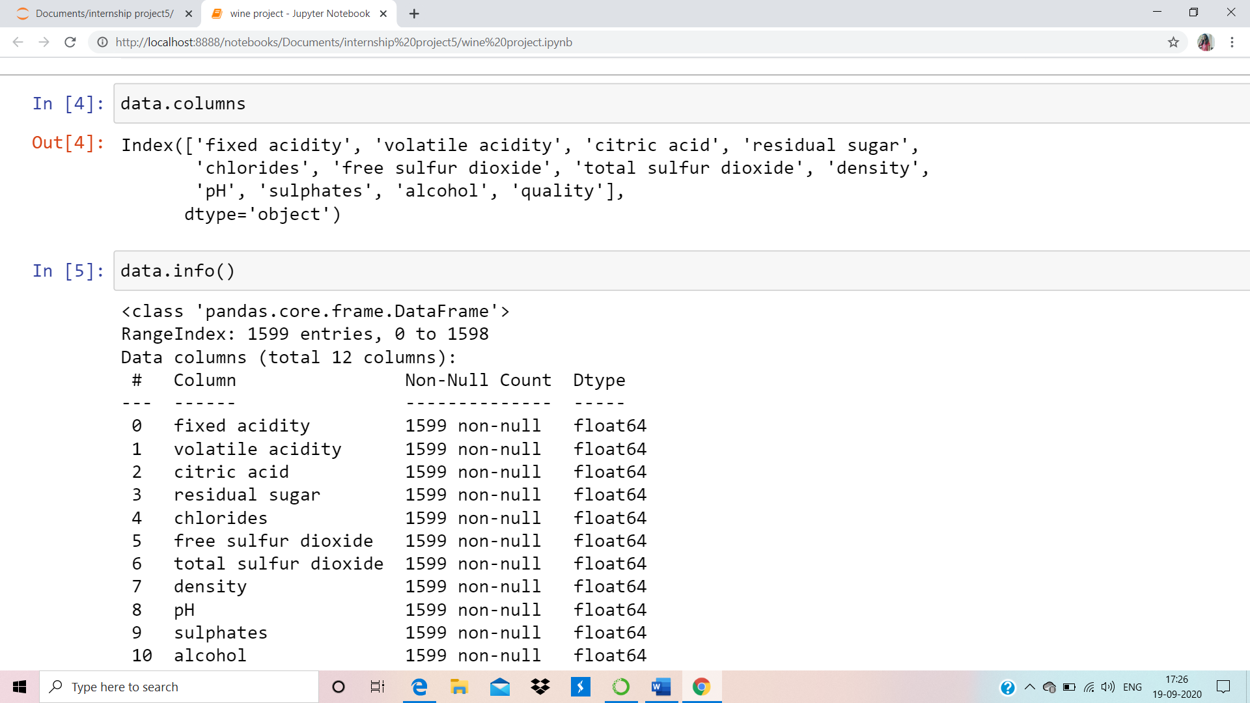
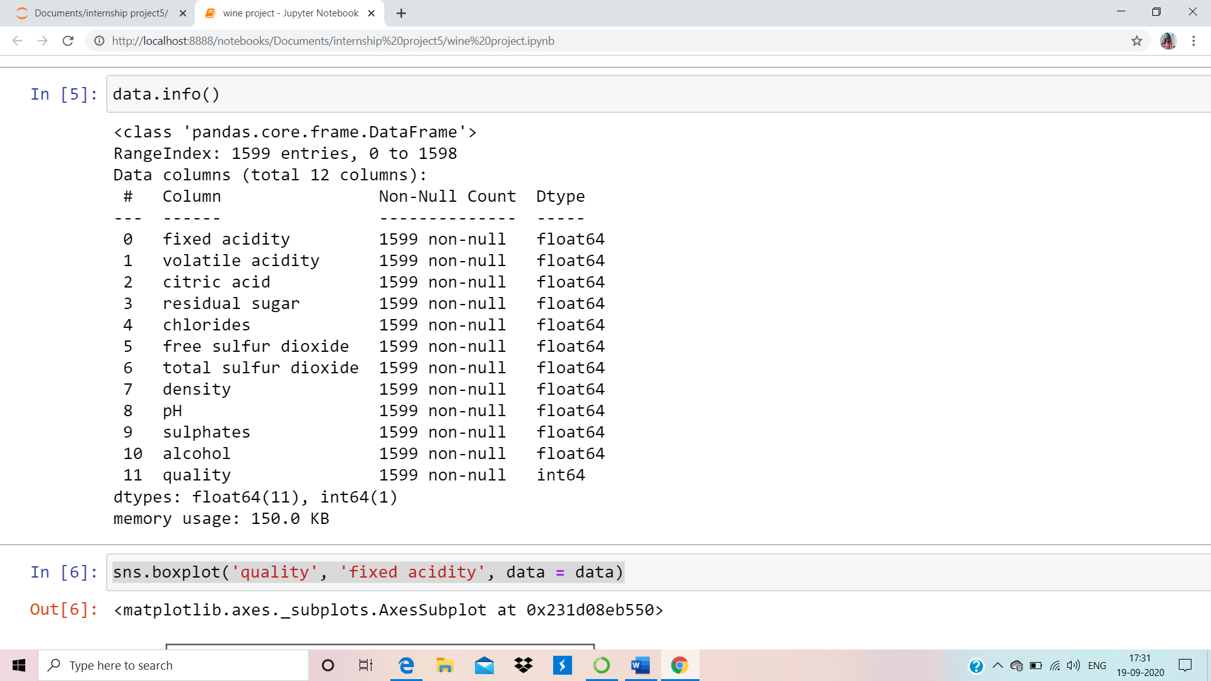

Slide 9
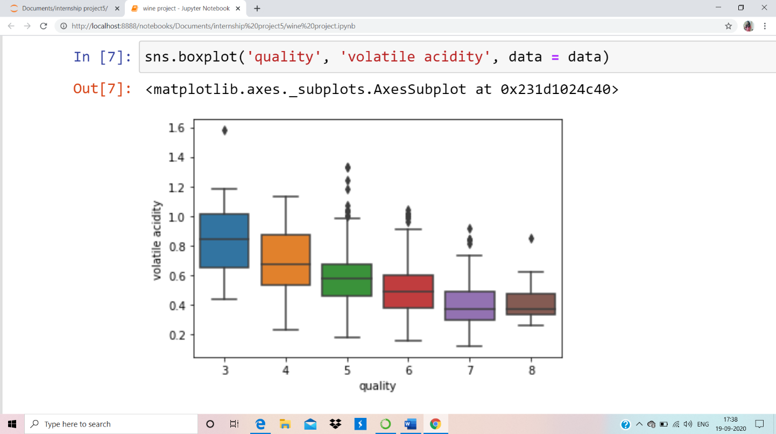
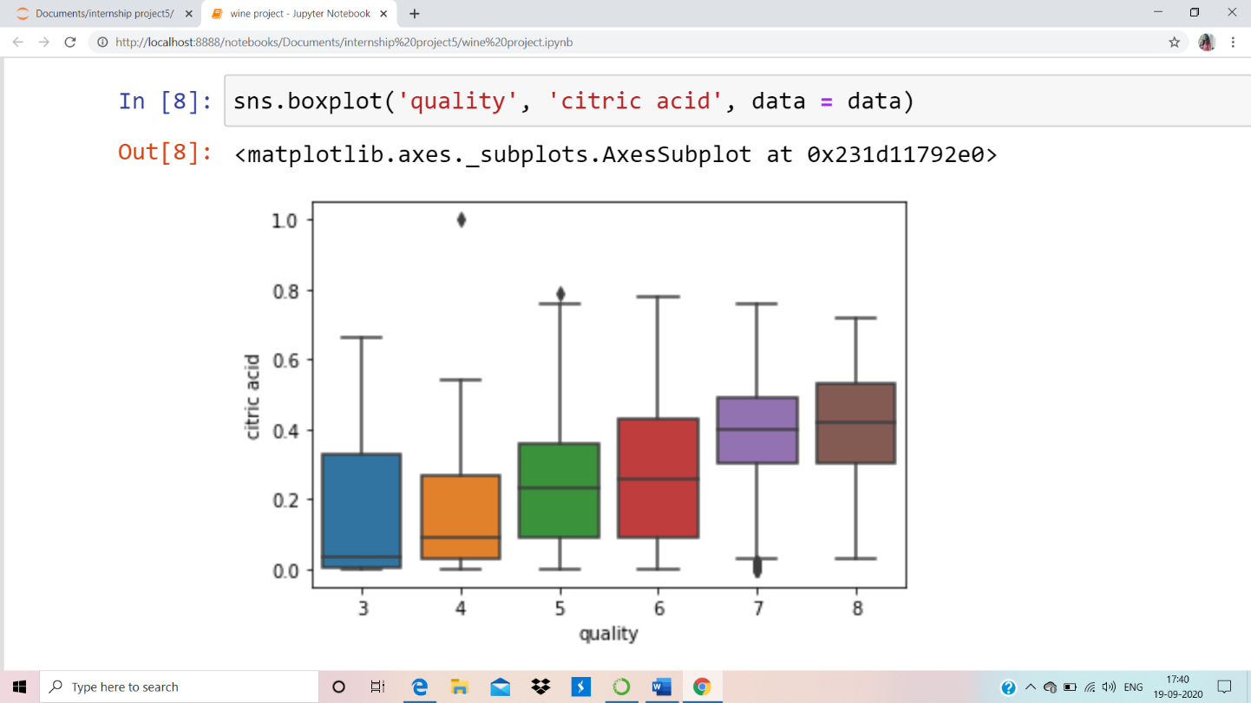
Visualization: Here we see that its quite a downing trend in the volatile acidity as we go higher the quality.
Visualization: Composition of citric acid goes higher as we go higher in the quality of the wine.

Slide 10
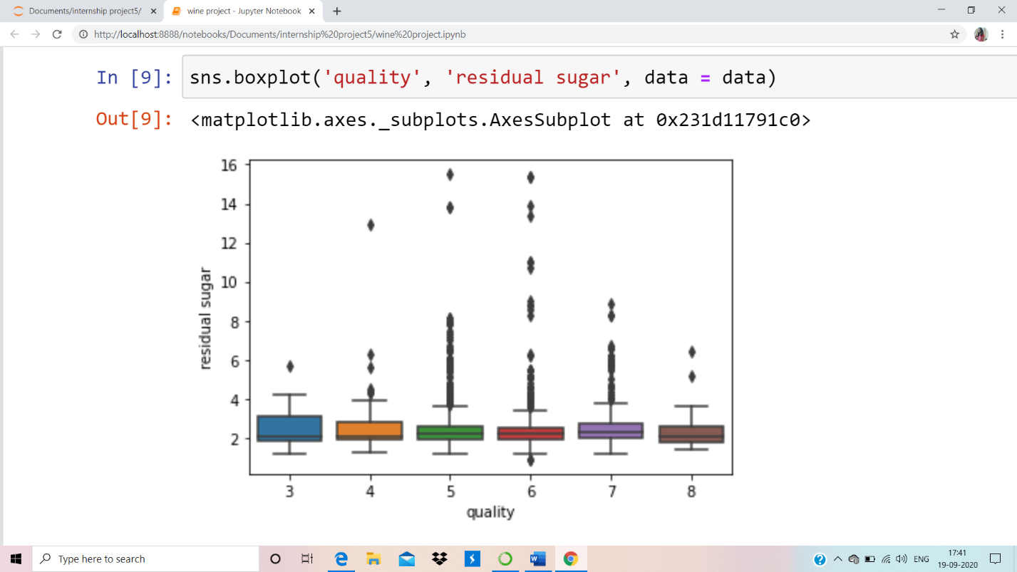
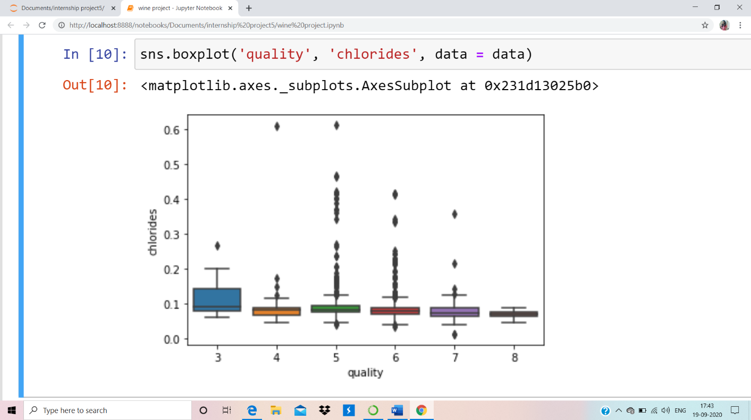
Visualization: Composition of residual sugar is uniformly distributed over the different quality level.
Visualization: Composition of chlorides also goes down as we go higher in the quality of the wine.

Slide 11
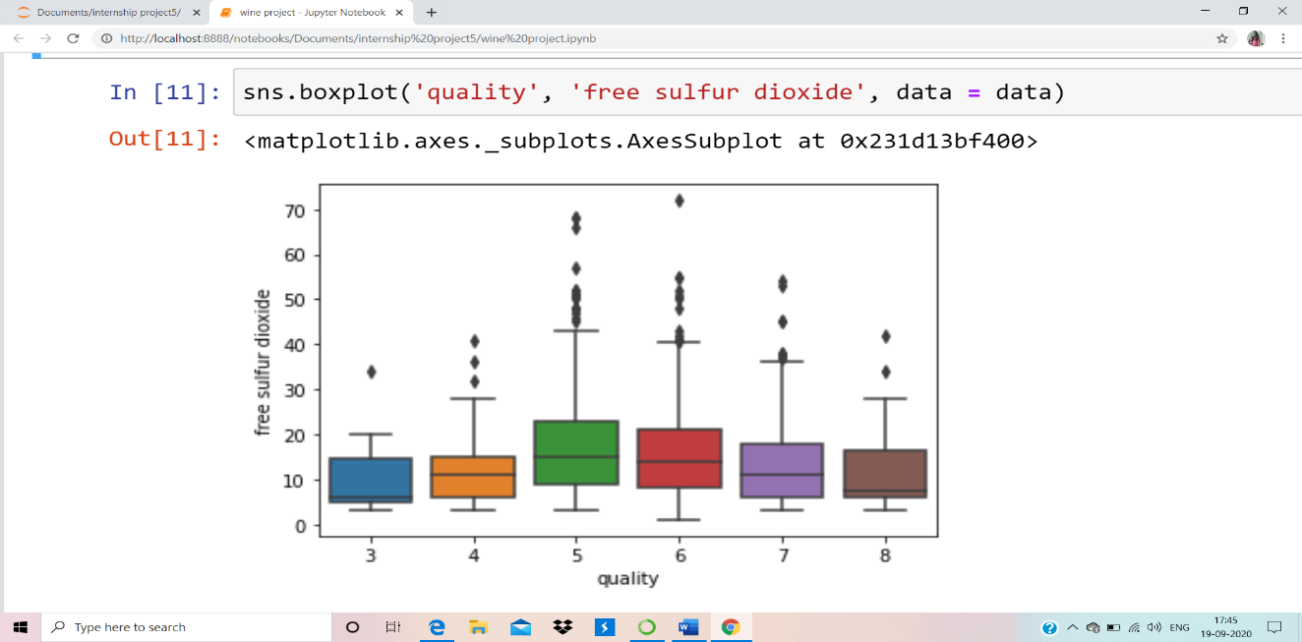
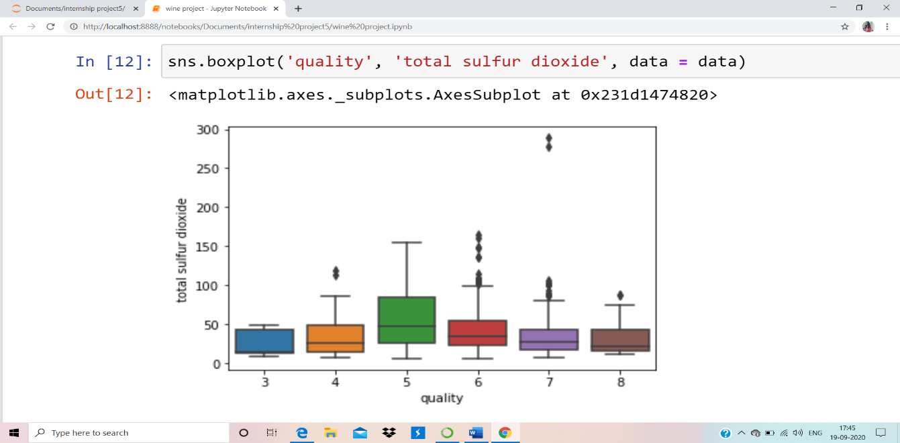
Visualization: Composition of free sulphur dioxide somewhat increases a bit in the quality levels of 5 and 6 and then again decreases.
Visualization: Composition of total sulphur dioxide lowers towards the high quality levels with an sudden increase in the quality level of 5.

Slide 12
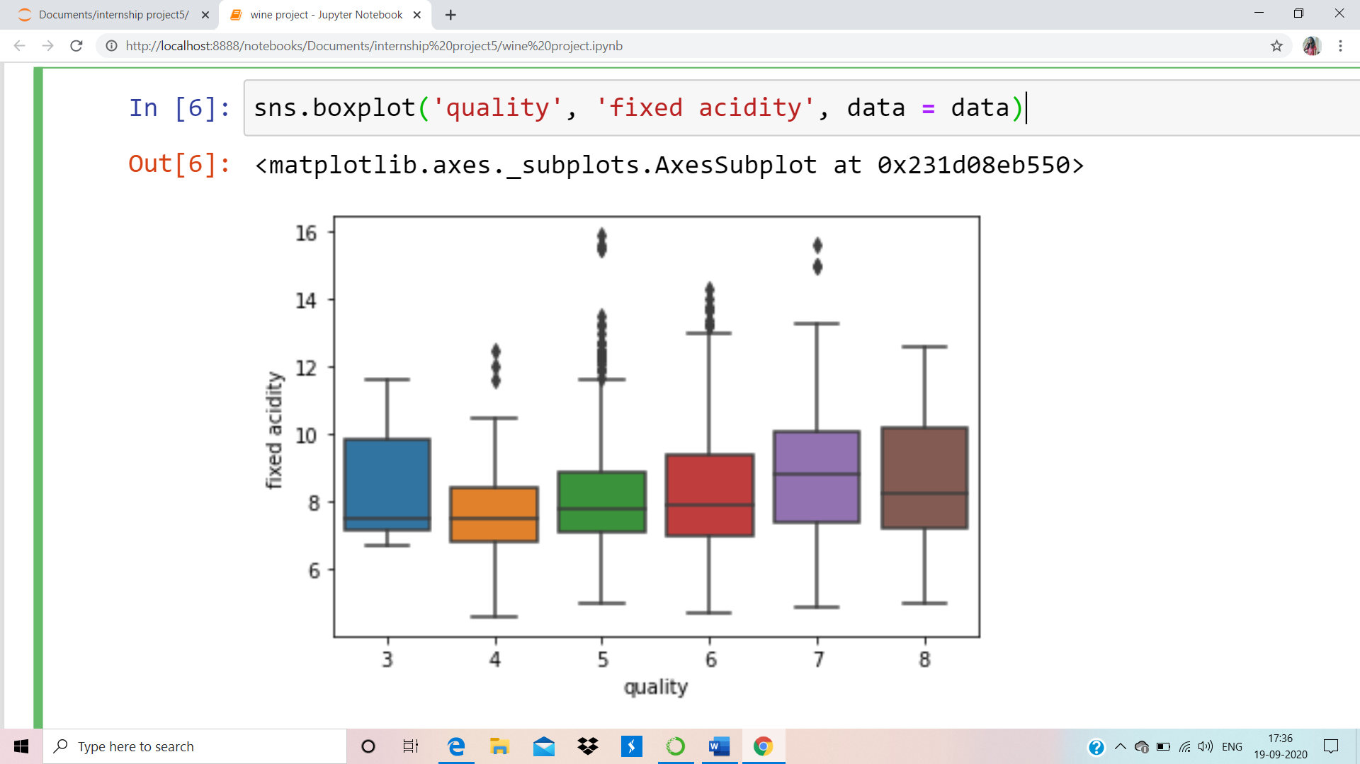
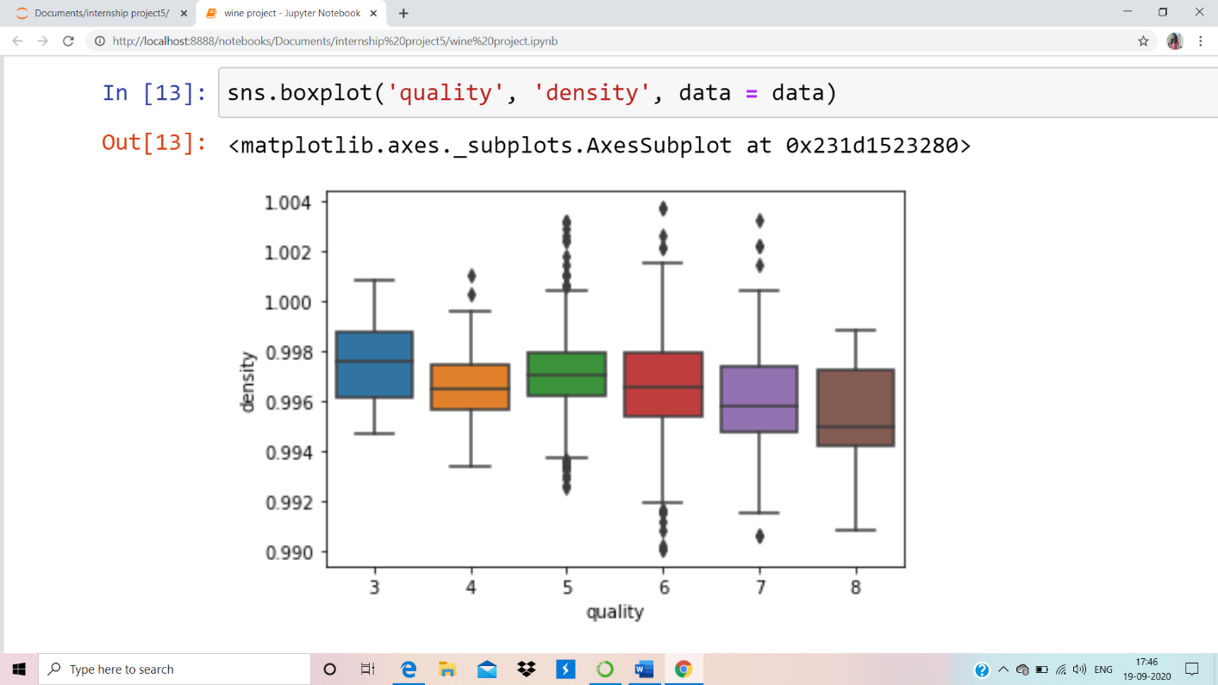
Visualization: Here we see that fixed acidity does not give any specification to classify the quality.
Visualization: Density of the red wine seems to be larger at the low quality levels and tends to decrease towards the high quality levels.

Slide 13
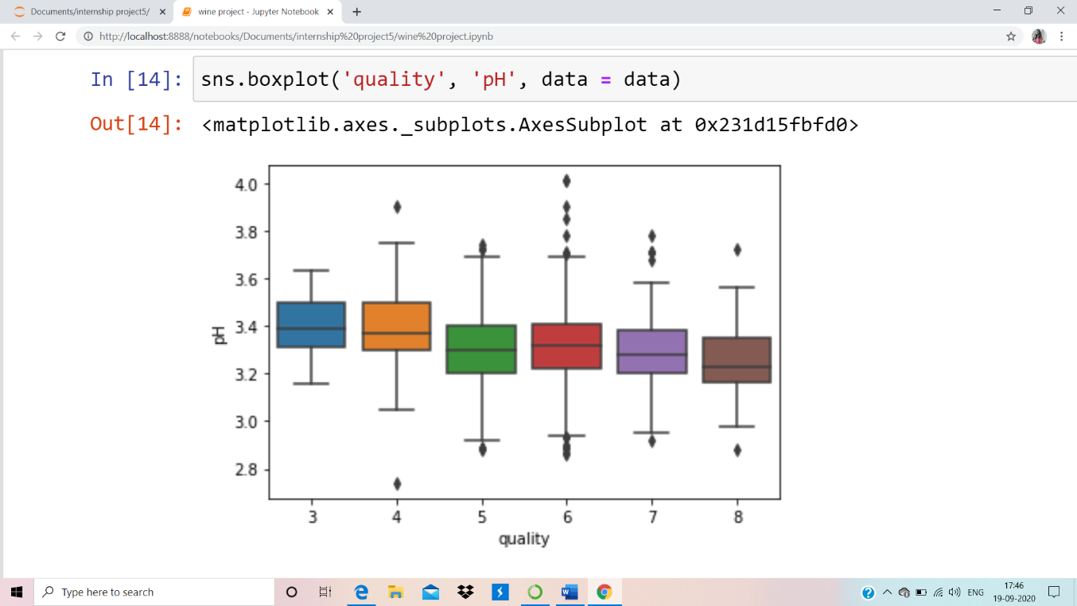
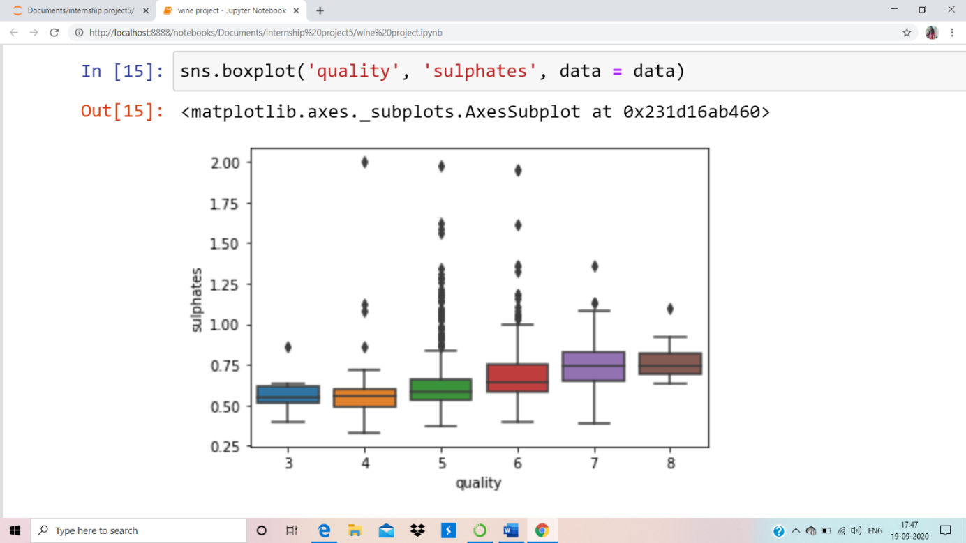
Visualization: The pH levels of the red wine seems to be uniformly distributed with the quality levels with the little increase
in the pH at the quality level 3 and 4.
Visualization: Sulphates level goes higher with the quality of wine.

Slide 14
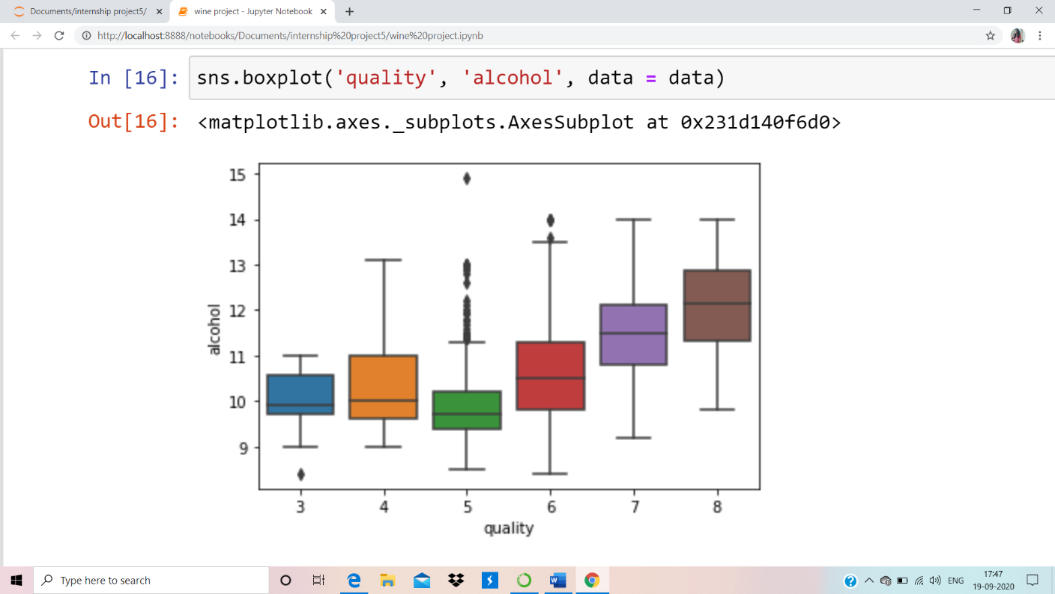
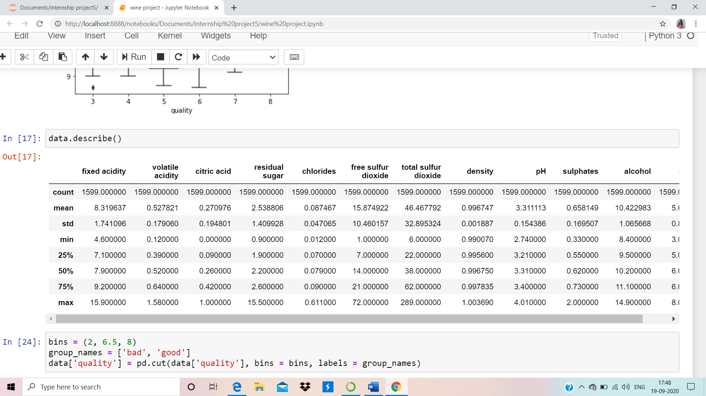
Visualization: Alcohol level also goes higher as the quality of wine increases.

Slide 15
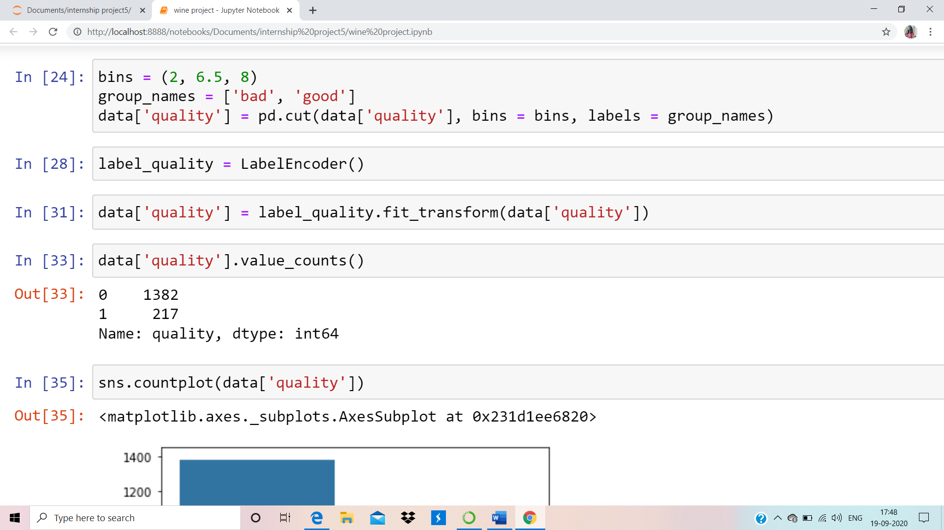
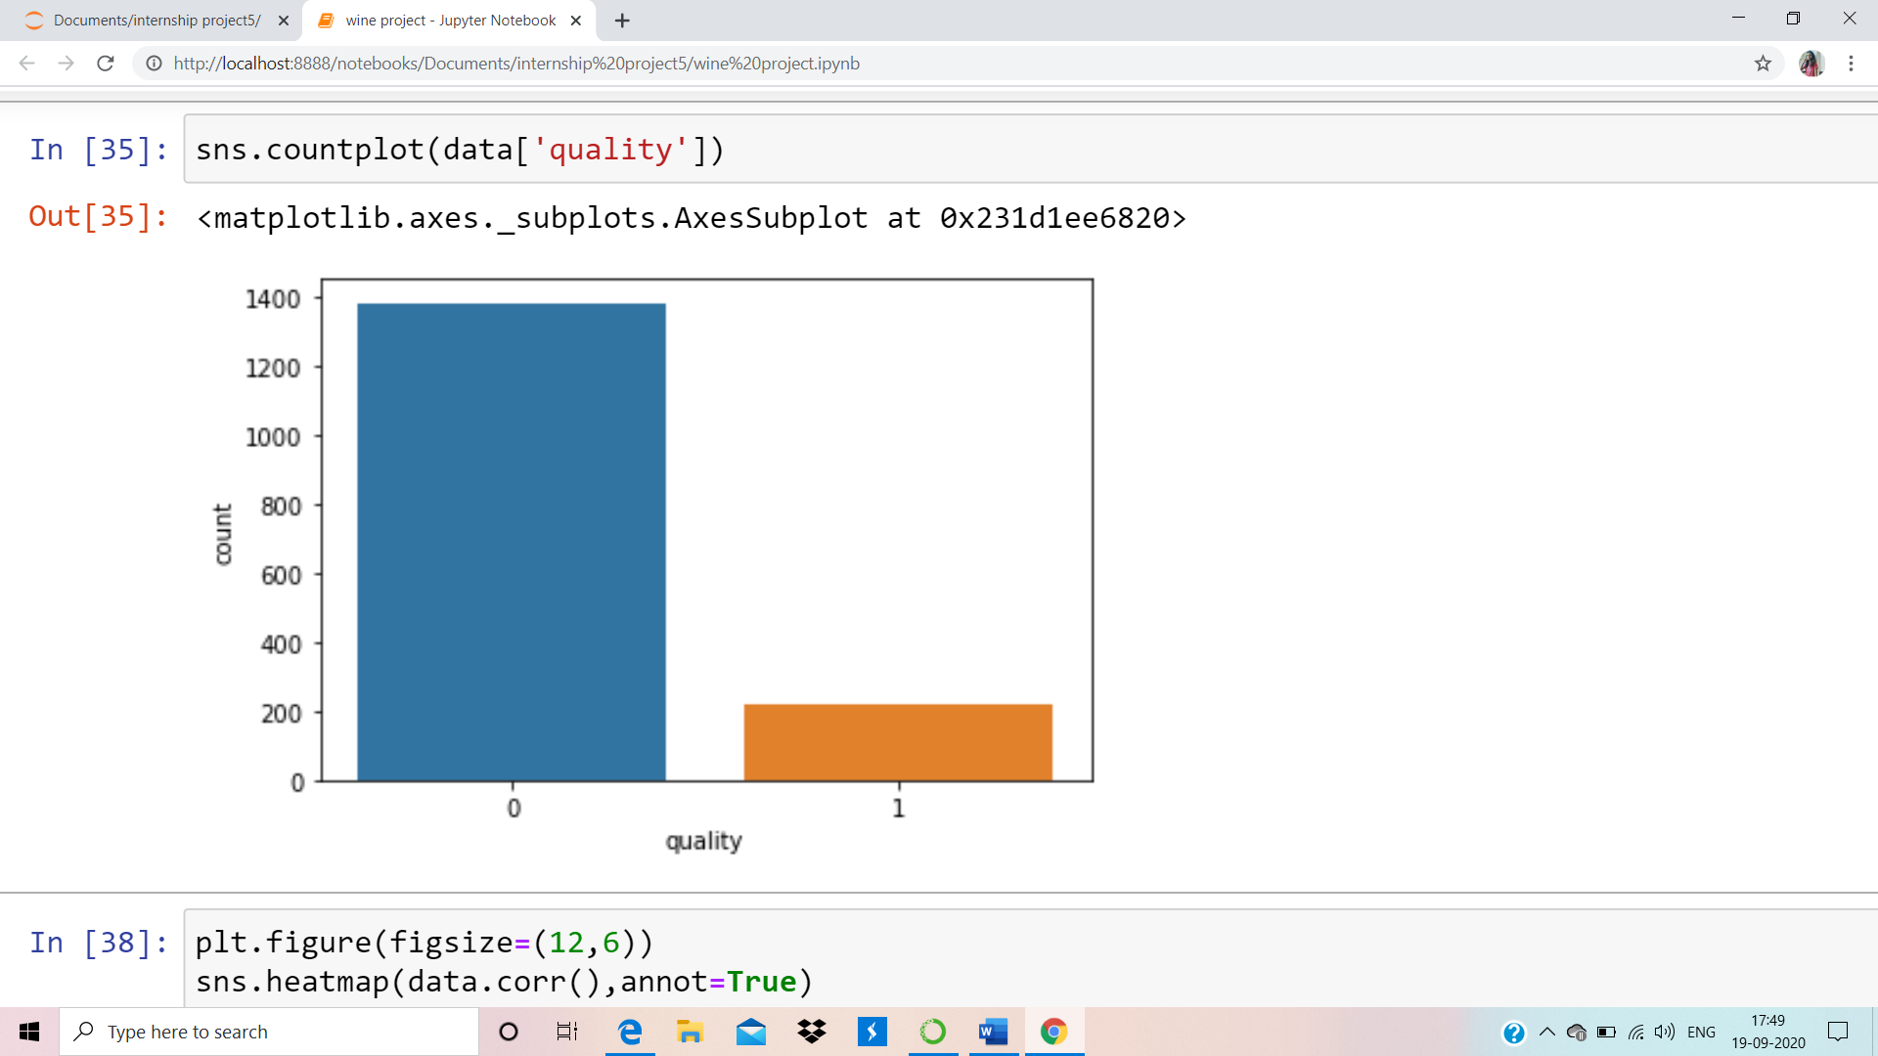
Visualization: From the above countplot we can see that there are large no. of wines with good quality=0
means whose quality levels are less than 7.

Slide 16
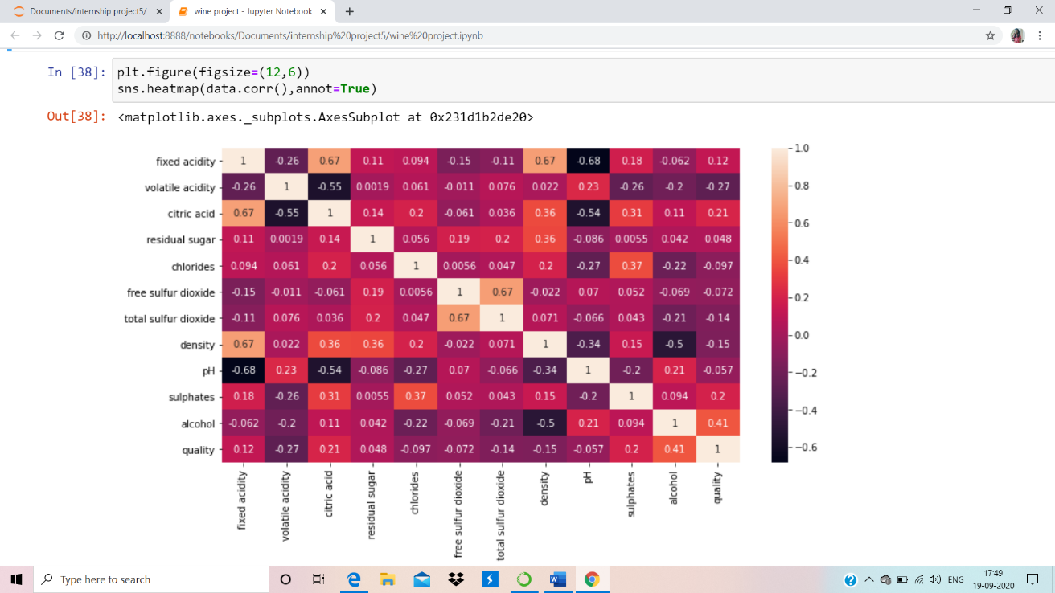
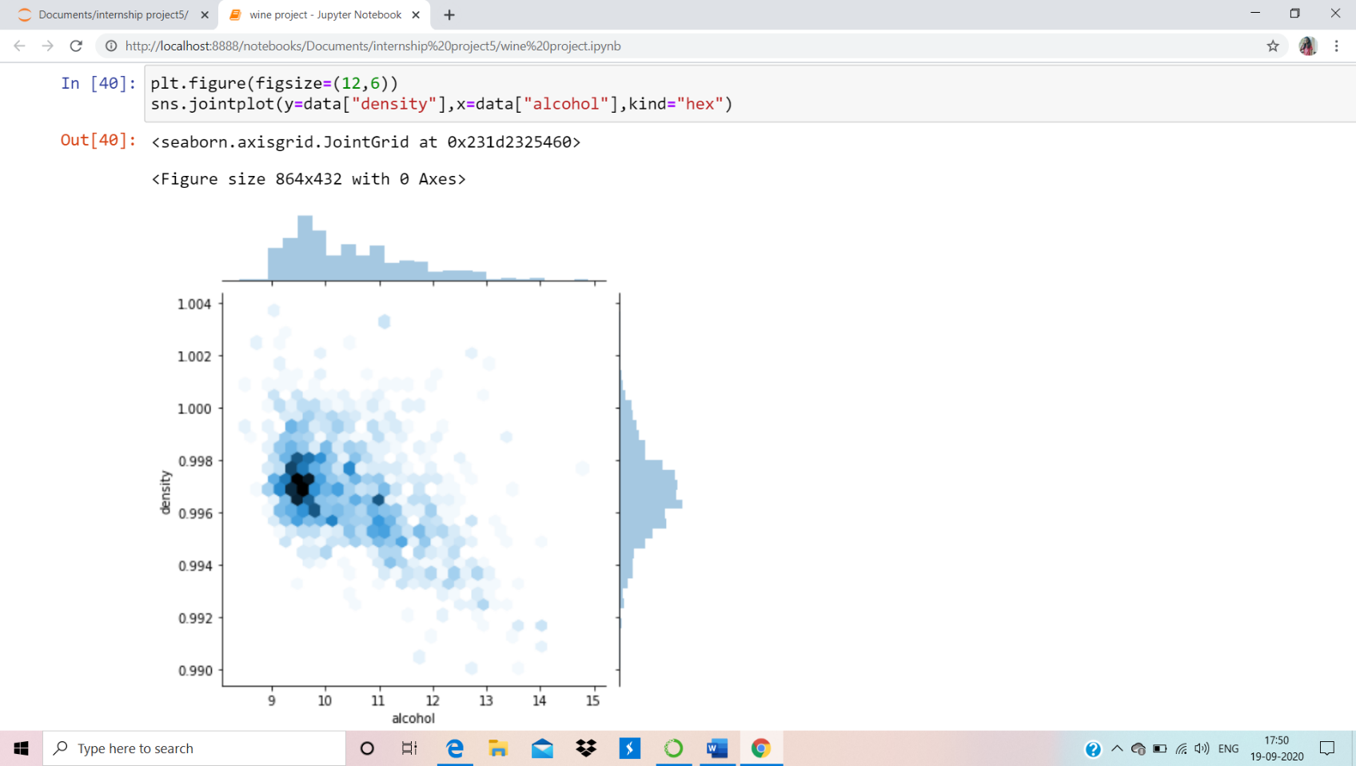

Slide 17
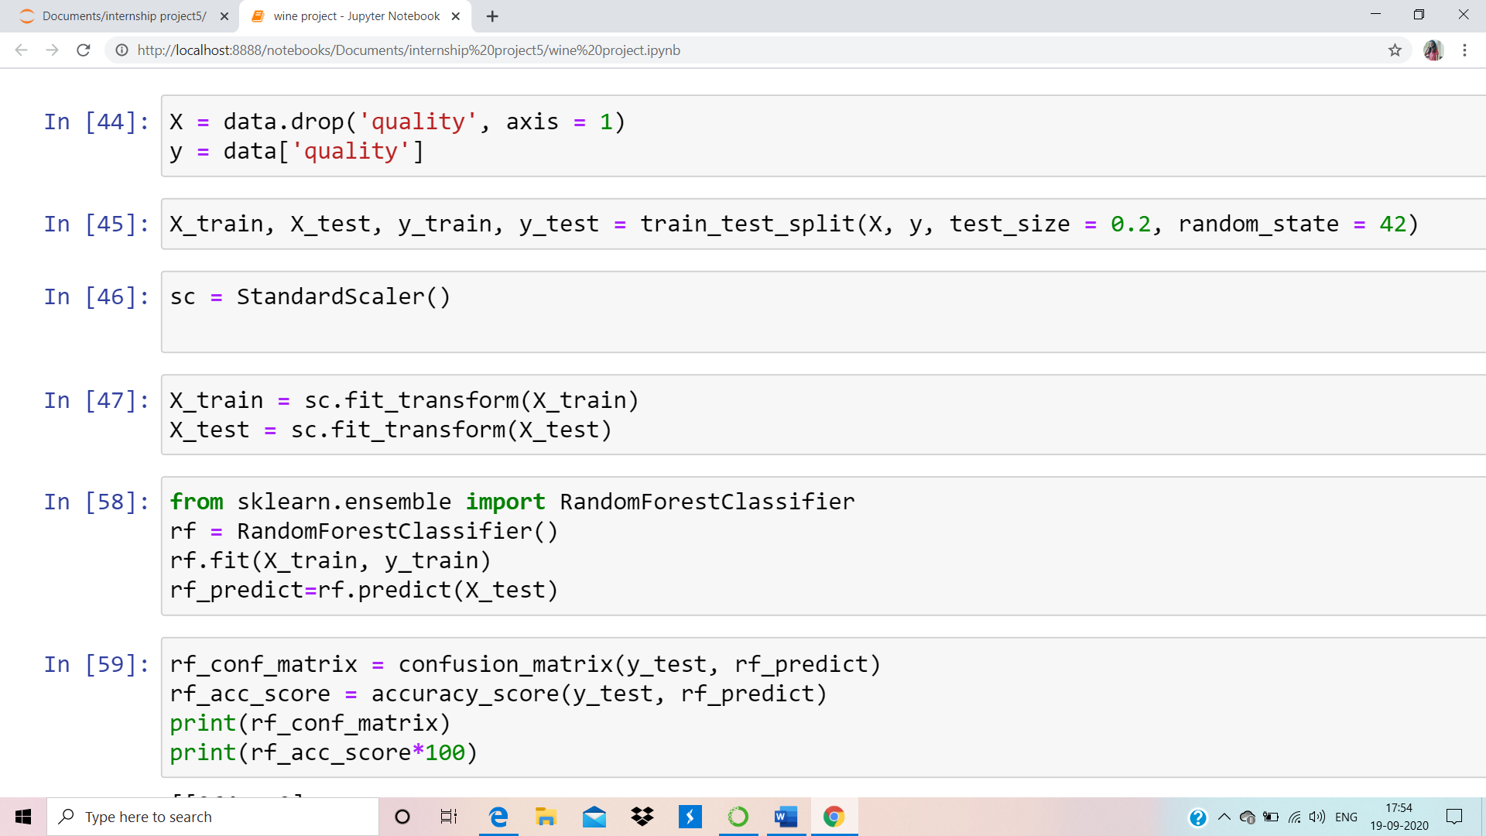
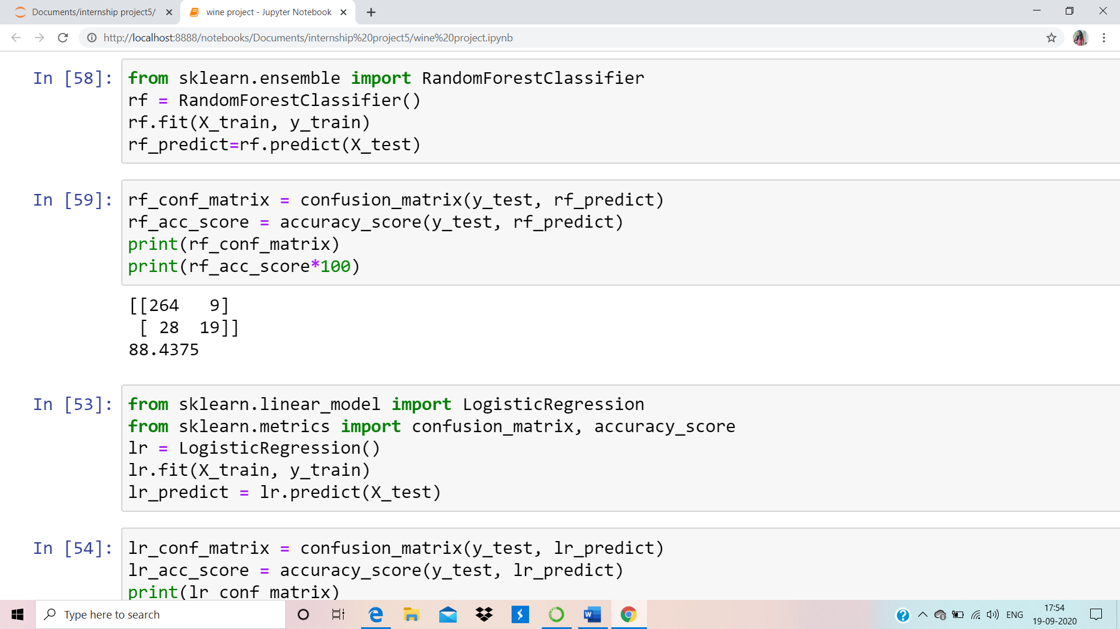
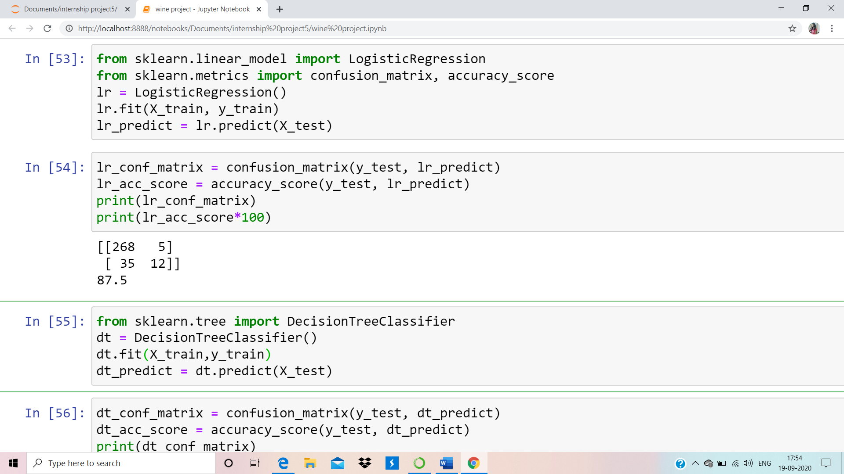

Slide 18
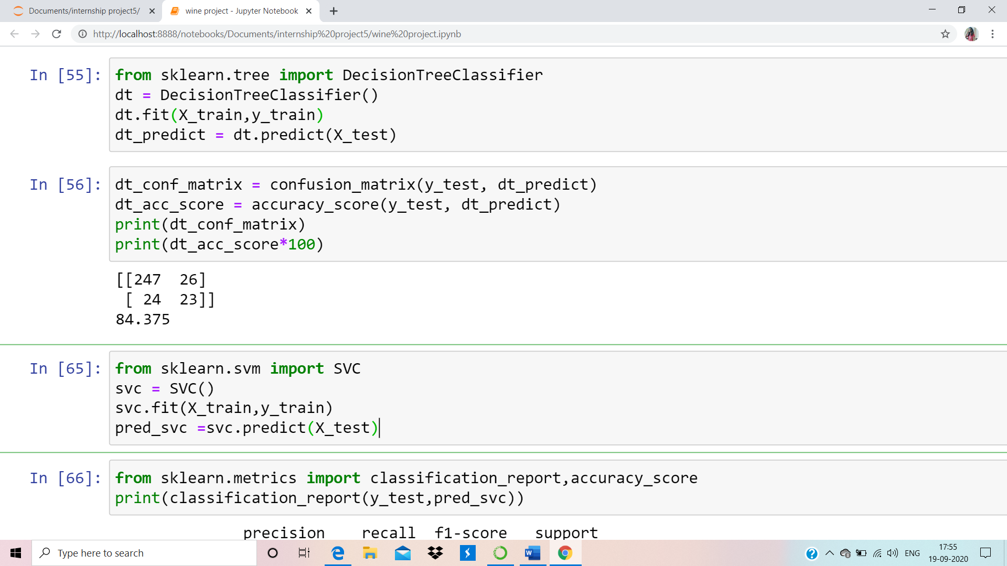
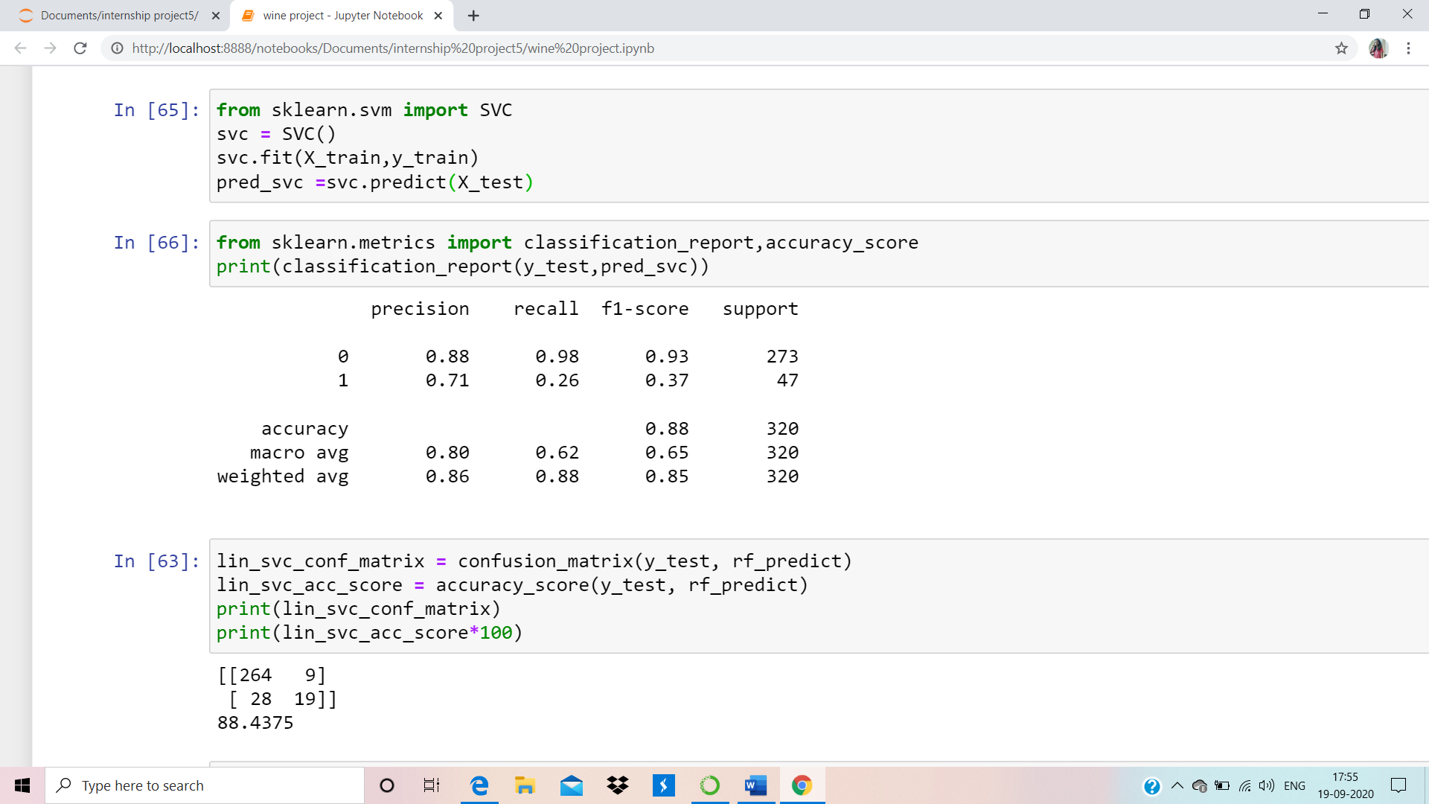

Slide 19
